Slide 1

Media+
Company Profile
Z.Charles
04/27/2022

Slide 2
context
Streaming platforms like Netflix and Amazon Prime Video are popular at the moment.
Lets create a content streaming website.

Slide 3
Problem to solve
How do we go about making our site?
What programming languages are we using to make this site?

Slide 4
Task
Following SDLC
Create an interactive web page that connects to an external API
Use javascript to make the site dynamic
Utilize CSS to style the webpage content

Slide 5

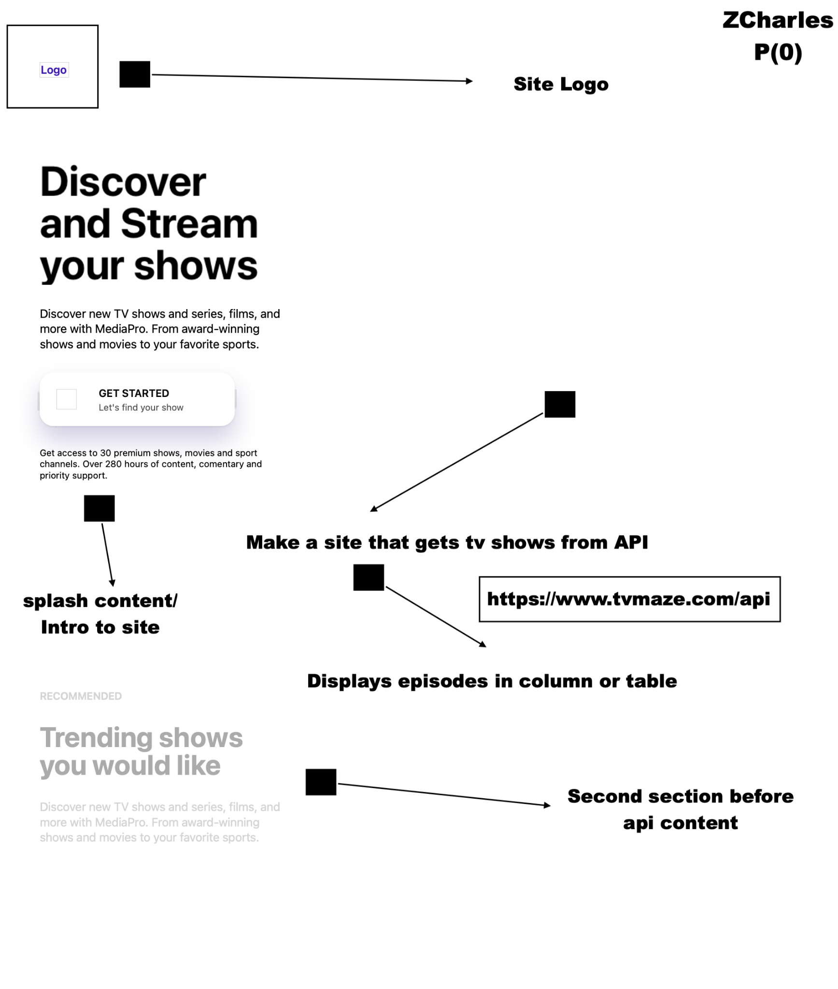
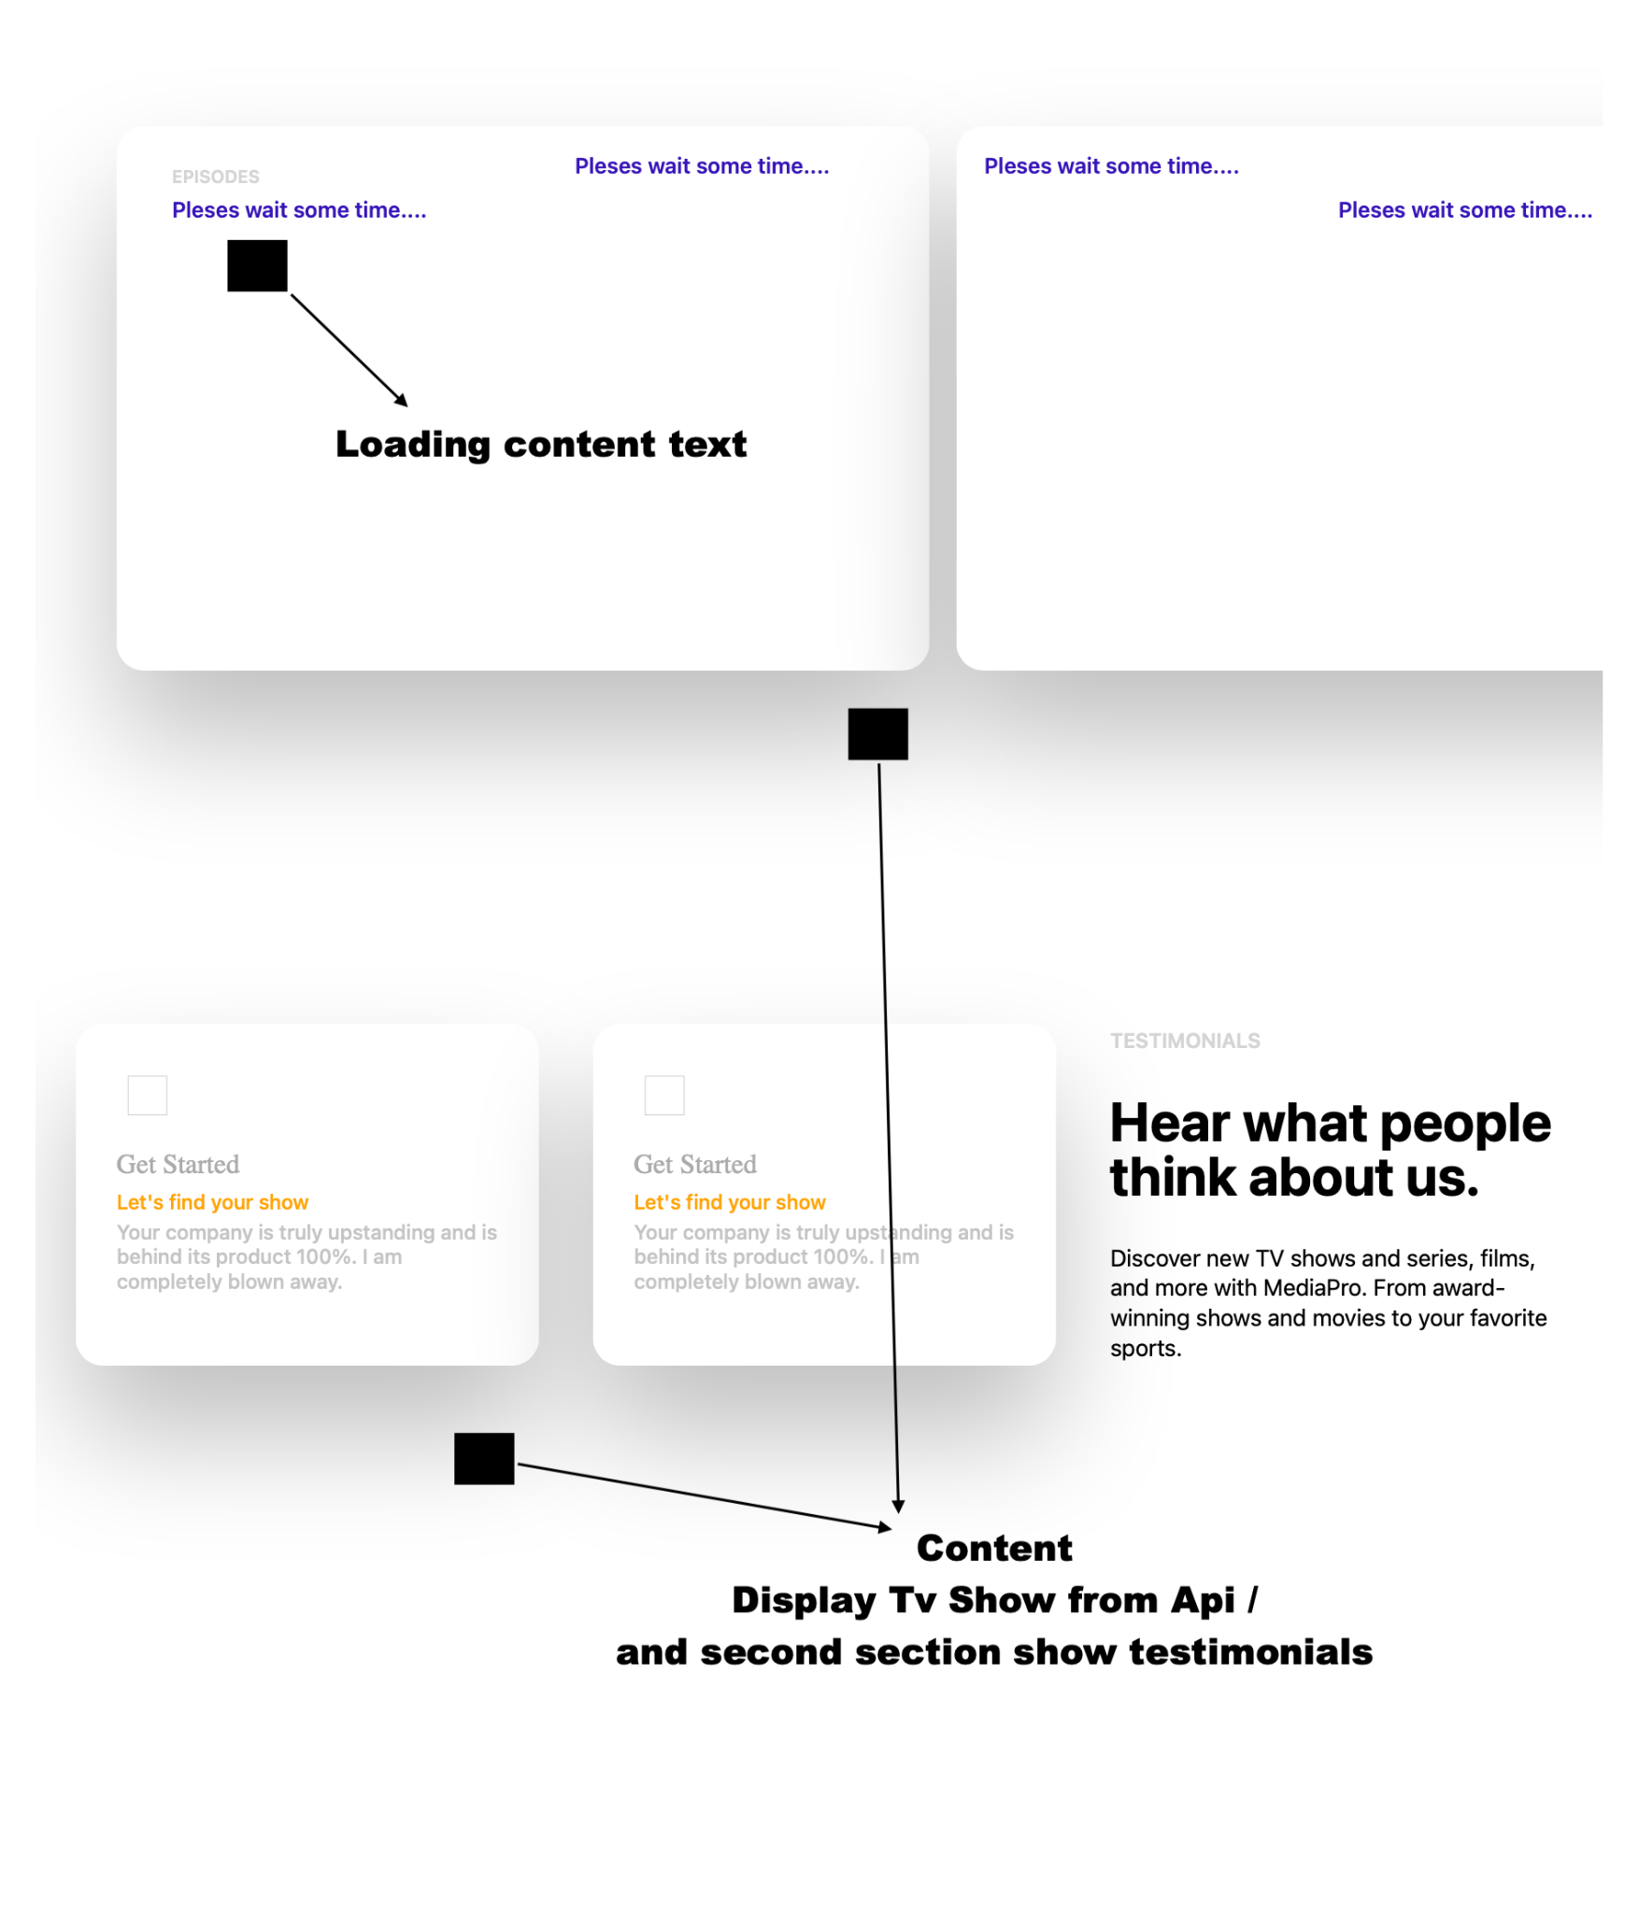
Wireframe
Background
DESIGN PHASE
Step 04
Mercury is the closest planet to the Sun
Splash Content
Step 01
Api content
https://www.tvmaze.com/api

Slide 6
Blockers
Syntax
Styling
Fetching Arrays in a JSON file

Slide 7
ANY questions?

